Slide 1
Classification On Breast Cancer

Slide 2
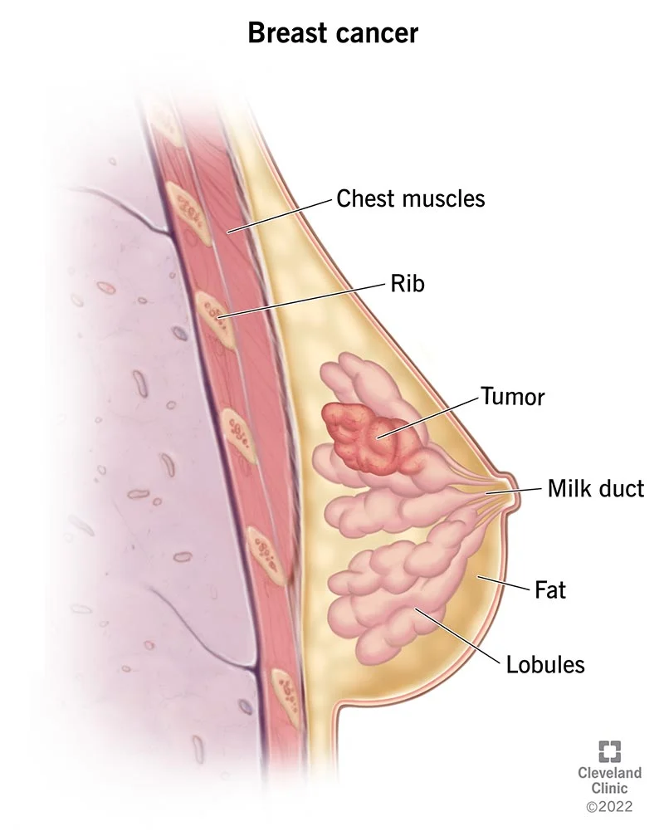
What is Breast Cancer?
An abnormal, uncontrolled cell growth arising in the breast tissue
Breast cancer is the second leading cause of death in women
Breast cancer primarily effects women but about 1 percent of all cases effect men
One third of women with breast cancer die from breast cancer

Slide 3
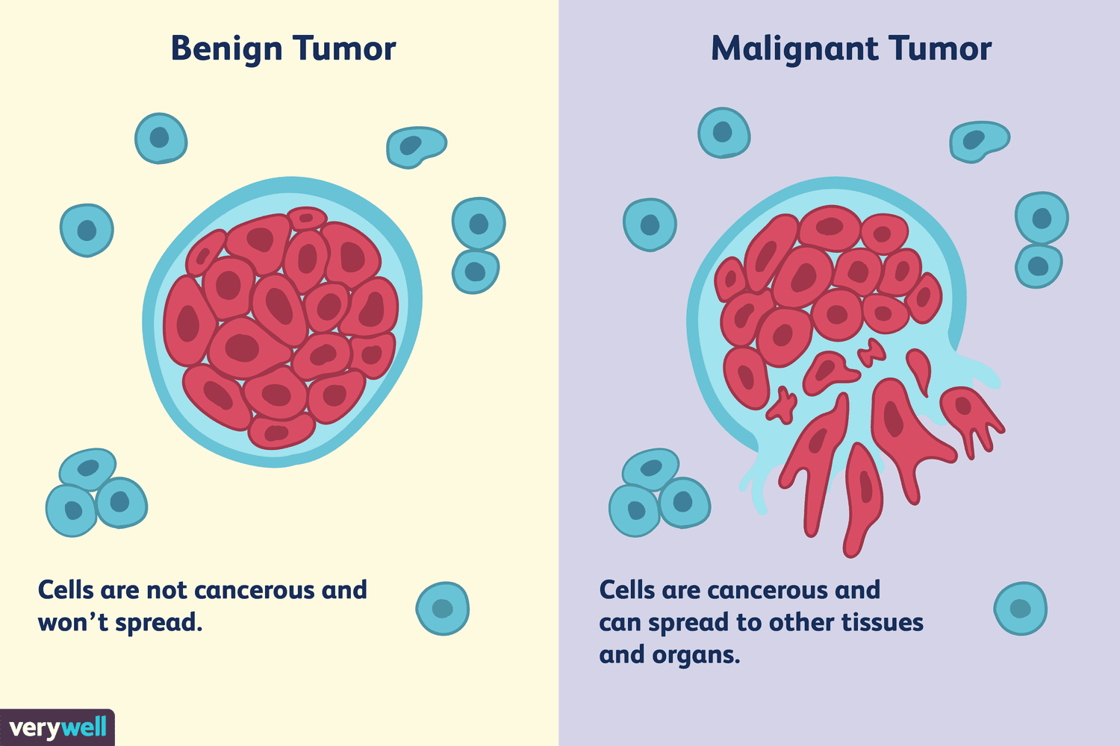
Types of Tumour Cells
Benign tumors
Aren't cancerous.
• They can often be removed
• In most cases, they do not come back.
• Cells in benign tumours do not spread to other parts of the body.
Malignant tumors
Are cancerous
Cells grow out of control.
Cells in these tumours can invade nearby tissues and spread to other parts of the body.

Slide 4
How machine learning is used in Breast cancer Detection?
Machine Learing is used in Breast Cancer Detection to predict the type of tumour cell.This technological advancement brings forth several critical advantages:
High Accuracy: Using ML algorithms ensures accurate predictions of breast cancer cell types, reducing misdiagnoses and establishing a dependable identification of cancer types.
Speedy Process for Early Detection: These models provide rapid analysis, enabling healthcare professionals to make quick decisions crucial for early detection.
Enhanced Early Detection: Early detection significantly improves treatment success rates and positively impacts patient prognosis.
Reduced Human Error: By mitigating human errors and biases in manual assessments, machine learning models enhance the overall reliability of the diagnostic process.
Potential for Personalized Treatment: Efficient identification of specific breast cancer cell types allows tailoring treatment plans based on cancer characteristics, promising more effective and personalized therapies for patients.

Slide 5
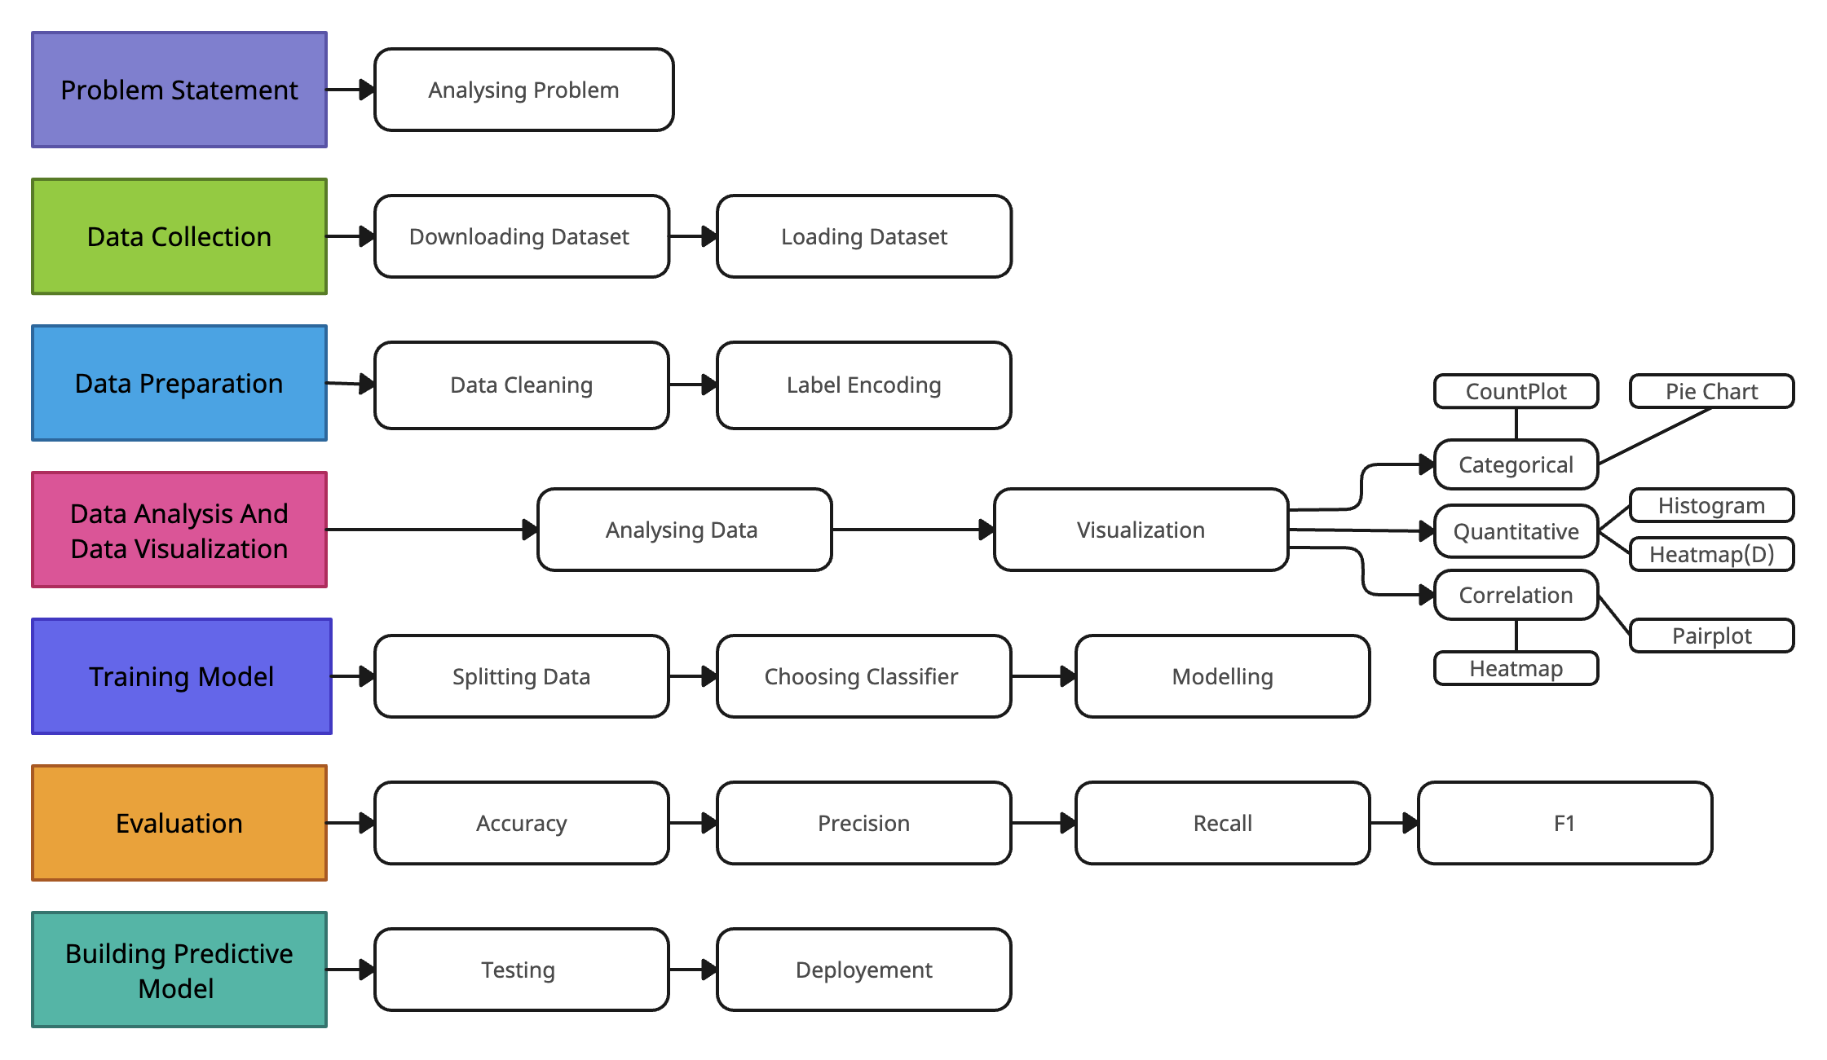
Flowchart

Slide 6
About Dataset
Breast Cancer Wisconsin (Diagnostic) is the Dataset used in this ML project, it is taken from obtained from the UC Irvine Machine Learning Repository. The Wisconsin Diagnostic Breast Cancer (WDBC) Dataset serves as a tool for differentiating between benign and cancerous tumors.
The dataset consists of 569 instances, each characterized by 32 attributes. These attributes include an Identification number and a Diagnosis code, where 'M' corresponds to malignant and 'B' to benign cases.
Among the features, noteworthy parameters such as radius, texture, perimeter, area, smoothness, compactness, concavity, concave points, symmetry, and fractal dimension for each cell nucleus are encompassed.These attributes are reported in three forms: mean, standard error, and "worst" contributing to a total of 30 features for each image.
The “Unnamed” column is irrelevant for this machine learning model and Thus it will be removed in the data cleaning process.

Slide 7
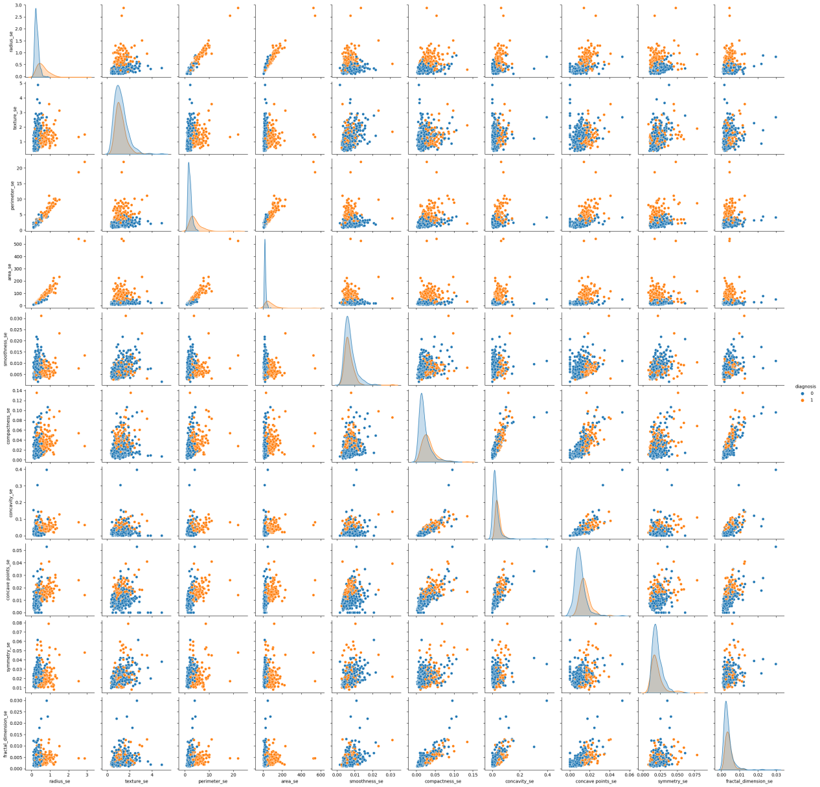
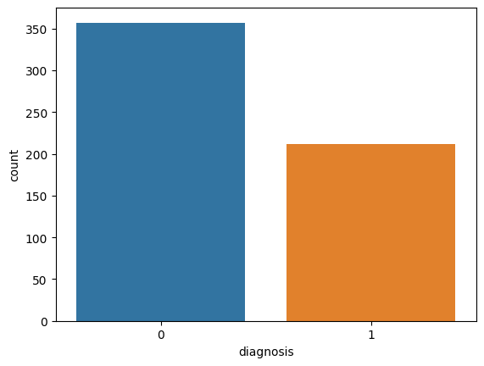
Data Visualization
Countplot: To show number of benign (repsented by 0) and malignant cancer pateint (represented by 1) .
Pairplot: Pairplot will show scatterplots for all combinations of numerical columns, and data points will be color-coded according to the 'diagnosis' column.

Slide 8
Model
Classification is a supervised learning which have input data and target values to classify. So we have created variable x which contains the whole dataset except ‘diagnosis’ and variable y contains the target attribute which is ‘diagnosis’.
Then we split the data into Training and testing data (75% data for training and 25% for test).
We use differenent classsifier for classification to find the Accuracy, Precision, Recall and F1-score and thus the find best model for our data set.The different classifier used are:-
DecisionTreeClassifier
GaussianNB
LogisticRegression
RandomForestClassifier
SupportVectorClassifier.

Slide 9
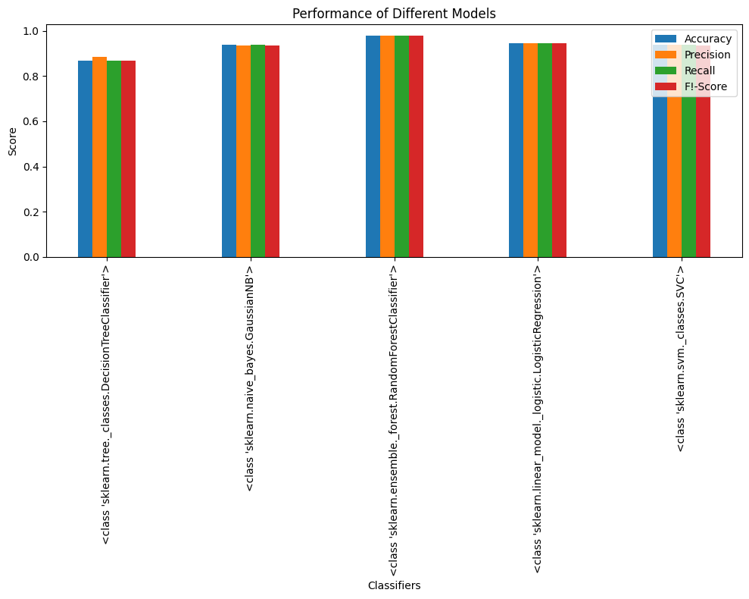
Result
Among the classifiers used Random Forest Classifier gives the highest accuracy which is 97.90% among the classifiers used in this machine learning.

Slide 10
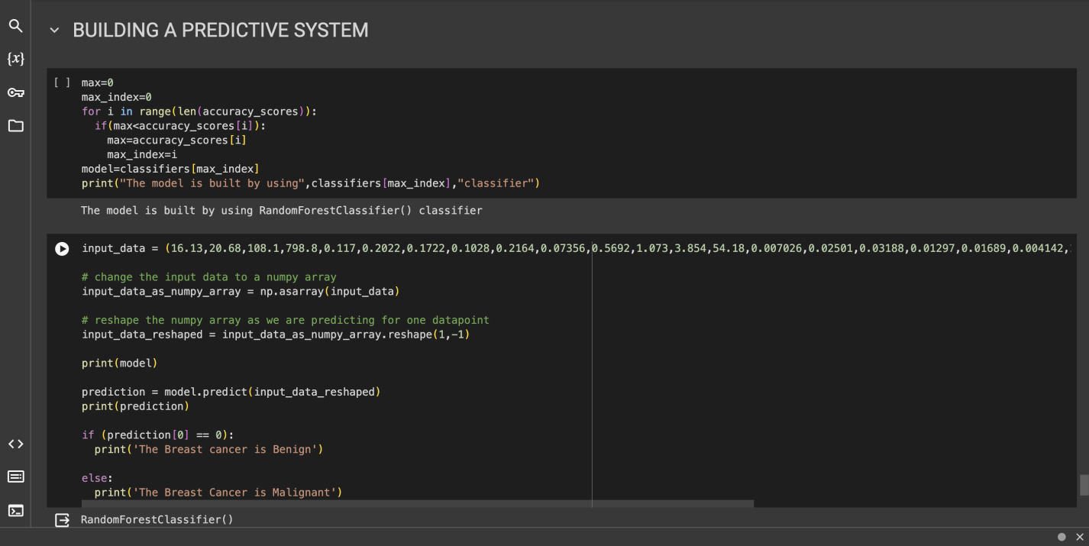
Predictive Model
To operationalize this model and make it accessible for real-world applications, we have constructed a predictive system. This system takes new data as input and employs the trained Random Forest classifier to make predictions about whether a patient's breast cancer diagnosis is malignant or benign.

Slide 11
Conclusion
In this study, we have leveraged machine learning techniques to develop a predictive model for the Breast Cancer Wisconsin (Diagnostic) dataset, with the primary goal of accurately predicting whether a patient has malignant or benign breast cancer.
Our study showcases the successful development of a predictive model for breast cancer diagnosis using the Random Forest classifier. This model, with its high accuracy, has the potential to improve early detection and, subsequently, patient outcomes.
By building a predictive system, we have made this model readily available for practical use, emphasizing its significance in the ongoing fight against breast cancer.

Slide 12
1
Using ML tools to obtain higher accuracy
Future Work
2
To deploy the model on a Website
3
To perform deep learning on other BC dataset
4
To make the website available for public

Slide 13
THANK YOU

